Slide 1

Session – 13 Scrum

Slide 2
Scrum Introduction
Scrum is a process framework used to manage product development and other knowledge work.
Scrum is empirical in that it provides a means for teams to establish a hypothesis of how they think something works, try it out, reflect on the experience, and make the appropriate adjustments. That is, when the framework is used properly.
Scrum is structured in a way that allows teams to incorporate practices from other frameworks where they make sense for the team’s context.
Scrum appears simple, yet has practices that deeply influence the work experience and that capture key adaptive and agile qualities.

Slide 3
What is Scrum?
Scrum:
Is an agile, lightweight process
Can manage and control software and product development
Uses iterative, incremental practices
Has a simple implementation
Increases productivity
Reduces time
Embraces the opposite of the waterfall approach…

Slide 4
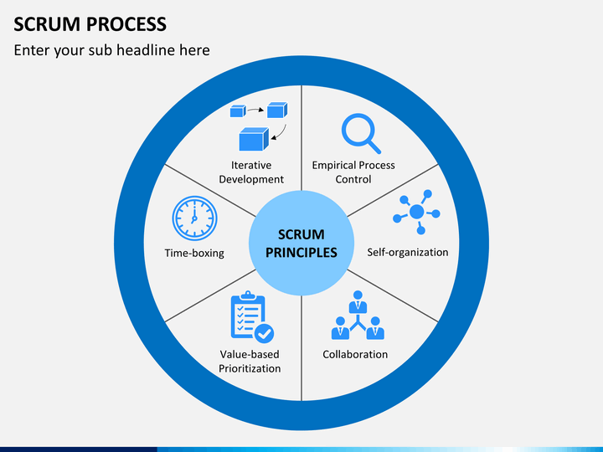
Scrum Principles

Slide 5
Scrum at a Glance
24 hours
Daily Scrum
Meeting
Backlog tasks
expanded
by team
30 days
Sprint Backlog
Potentially Shippable
Product Increment
Product Backlog
As prioritized by Product Owner
Source: Adapted from Agile Software Development with Scrum by Ken Schwaber and Mike Beedle.

Slide 6

Scrum Framework
Roles
Ceremonies
Product owner
Scrum Master
ProjectTeam
Sprint planning
Daily scrum meeting
Sprint review
Sprint retrospective
Artifacts/work products
Product backlog
Sprint backlog
Burndown charts

Slide 7







Scrum Roles
Product Owner
Possibly a Product Manager or Project Sponsor
Decides features, release date, prioritization, $$$
Scrum Master
Typically a Project Manager or Team Leader
Responsible for enacting Scrum values and practices
Remove impediments / politics, keeps everyone productive
Project Team
5-10 members; Teams are self-organizing
Cross-functional: QA, Programmers, UI Designers, etc.
Membership should change only between sprints

Slide 8
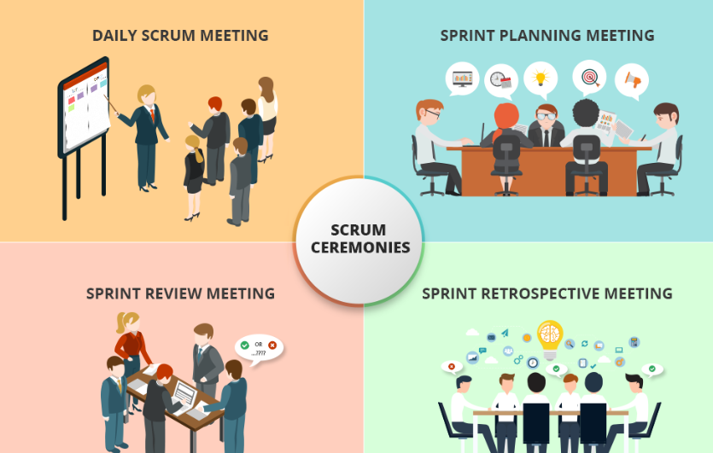
Scrum Ceremonies

Slide 9



Sprint Planning Mtg.
Sprint prioritization
Sprint planning
Sprint
goal
Sprint
backlog
Analyze/evaluate product backlog
Select sprint goal
Decide how to achieve sprint goal (design)
Create sprint backlog (tasks) from product backlog items (user stories / features)
Estimate sprint backlog in hours
Business conditions
Sprint planning meeting
Current product
Technology
Team capacity
Product backlog

Slide 10
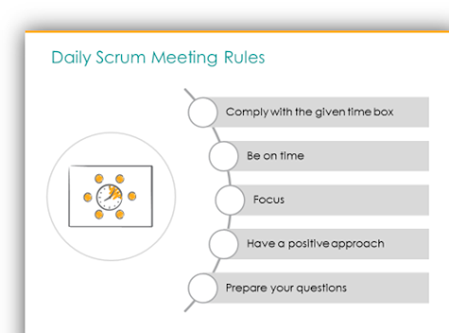
Daily Scrum Meeting
Parameters
Daily, 15 minutes, Stand-up
Anyone late pays a $1 fee
Not for problem solving
Whole world is invited
Only team members, Scrum Master, Product owner, can talk
Helps avoid other unnecessary meetings
Three questions answered by each team member:
What did you do yesterday?
What will you do today?
What obstacles are in your way?

Slide 11
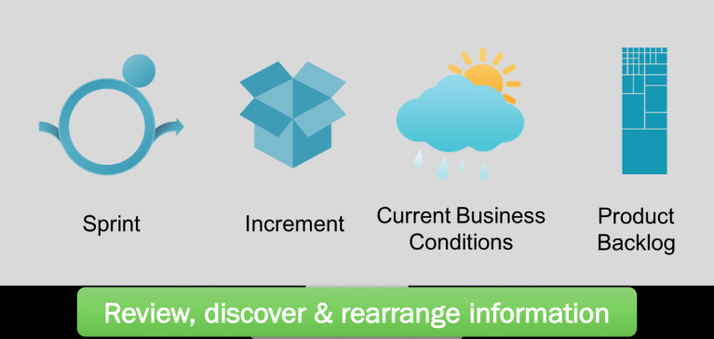
Sprint Review
Sprint Review is held at the end of the Sprint
to inspect the Increment and adapt the
Product Backlog if needed.
Attendees: Scrum Team and key stakeholders;
Product Owner: explains what Product Backlog items have been “Done” and what has not been “Done”; he projects likely target and delivery dates based on progress to date (if needed);
Development Team: what went well, what problems it ran into, and how those problems were solved;
The Development Team demonstrates the work that it has “Done” and answers questions about the Increment;
The Product Owner or Team or entire group collaborates on what to do next, so that the Sprint Review provides valuable input to subsequent Sprint Planning

Slide 12
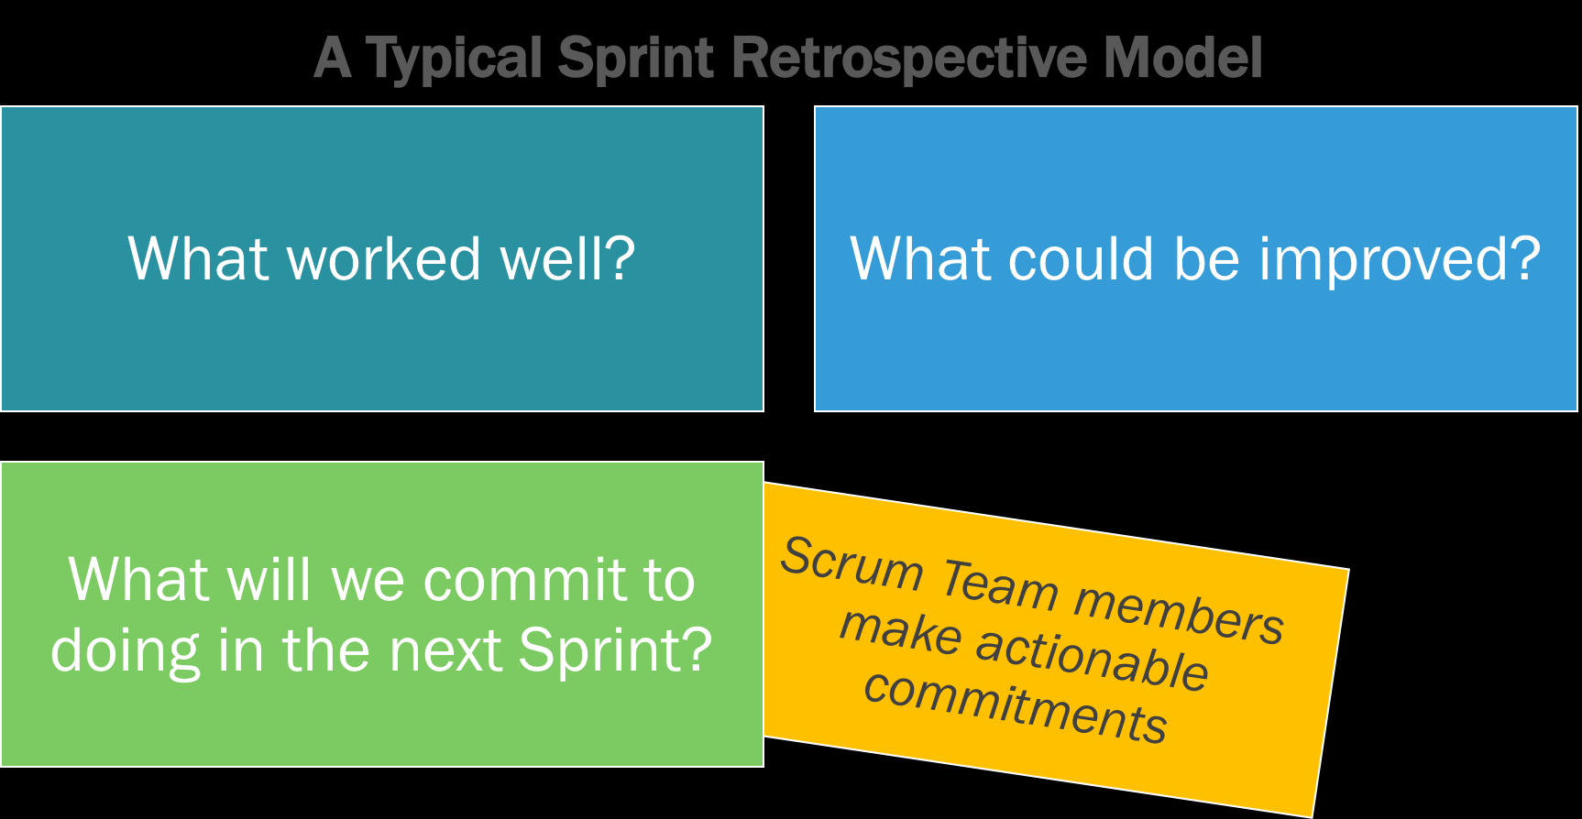
Sprint Retrospective

Slide 13
Scrum's Artifacts/Work products
Scrum has remarkably few artifacts
Product Backlog
Sprint Backlog
Burndown Charts
Can be managed using just an Excel spreadsheet
More advanced / complicated tools exist:
Expensive
Web-based – no good for Scrum Master/project manager who travels
Still under development

Slide 14

Product Backlog
The requirements
A list of all desired work on project
Ideally expressed as a list of user stories along with "story points", such that each item has value to users or customers of the product
Prioritized by the product owner
Reprioritized at start of each sprint
This is the product backlog

Slide 15
User Stories
Instead of Use Cases, Agile project owners do "user stories"
Who (user role) – Is this a customer, employee, admin, etc.?
What (goal) – What functionality must be achieved/developed ?
Why (reason) – Why does user want to accomplish this goal?
As a [user role], I want to [goal], so I can [reason].
Example:
"As a user, I want to log in, so I can access subscriber content."
story points:is a metric used to estimate the difficulty of implementing a given user story. A number that tells the team about the difficulty level of the story.
Rating of effort needed to implement this story
common scales: 1-10, shirt sizes (XS, S, M, L, XL), etc.

Slide 16
Sprint Backlog
Individuals sign up for work of their own choosing
Work is never assigned
Estimated work remaining is updated daily
Any team member can add, delete change sprint backlog
Work for the sprint emerges
If work is unclear, define a sprint backlog item with a larger amount of time and break it down later
Update work remaining as more becomes known

Slide 17
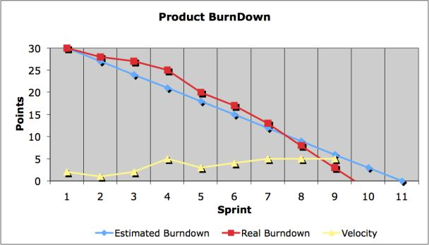
Burndown Chart
It is a visual measurement tool that shows the completed work per day against the projected rate of completion for the current project release. Its purpose is to enable that the project is on the track to deliver the expected solution within the desired schedule.

Slide 18
Questions
Define SCRUM.
Explain Method Overview of scrum.
Sketch and explain Lifecycle of scrum.
Explain Workproducts, Roles, and Practices.

Slide 19
End of Session 13

Slide 20
Session – 14
Scrum Cont..

Slide 21
The Scrum Meeting: Details
The Scrum Meeting—or scrum—is the heartbeat of Scrum and the project. Each workday at the same time and place, hold a meeting with the team members standing in a circle, at which time the same special questions are answered by each member:
1. What have you done since the last Scrum?
2. What will you do between now and the next Scrum?
3. What is getting in the way (blocks) of meeting the iteration goals?
4. Any tasks to add to the Sprint Backlog
5. The last question provides an efficient forum for a continuously improving and learning group

Slide 22
Some key practices
self-directed and self-organizing team
no external addition of work to an iteration, once chosen
daily stand-up meeting with special questions
usually 30-calendar day iterations
demo to external stakeholders at end of each iteration
each iteration, client-driven adaptive planning

Slide 23
Other Practices and Values
Other Practices:
Workers daily update the Sprint Backlog
No PERT charts allowed
Scrum Master reinforces vision
Replace ineffective Scrum Master
Scrum Values:
Commitment: Team members personally commit to achieving team goals
Courage: Team members do the right thing and work on tough problems.
Focus: Concentrate on the work identified for the sprint and the goals of the team.
Openness: Team members and stakeholders are open about all the work and the challenges the team encounters.
Respect: Team members respect each other to be capable and independent.

Slide 24
Common Mistakes and Misunderstandings
Not a self-directed team; managers or Scrum Master direct or organize the team
No daily update of the Sprint Backlog by members or daily tracker
New work added to iteration or individual
Product Owner isn't involved or doesn't decide
No Sprint Review
Many masters
Documentation is bad
Design or diagramming is bad
Full team (including customers and management) not briefed in Scrum and its values
Scrum Meeting too long or unfocused
Predictive planning; PERT chart planning

Slide 25
Adoption Strategies
12 Must do’s for successful adoption of Agile Scrum methodology:
Assess Project for readiness & suitability
Identify a ‘Go-Get-It’ team
Pilot when maximum teams are ready to fly
Convince the party poopers
Be Patient while transformation
Set a high bar and low expectations
Handhold to smoothen friction
Be open to Experts’ help
Make Good Information More Accessible
Find Your Evangelists
Measure the Results Early and Often
Be sure what’s Scrum and what’s Not

Slide 26
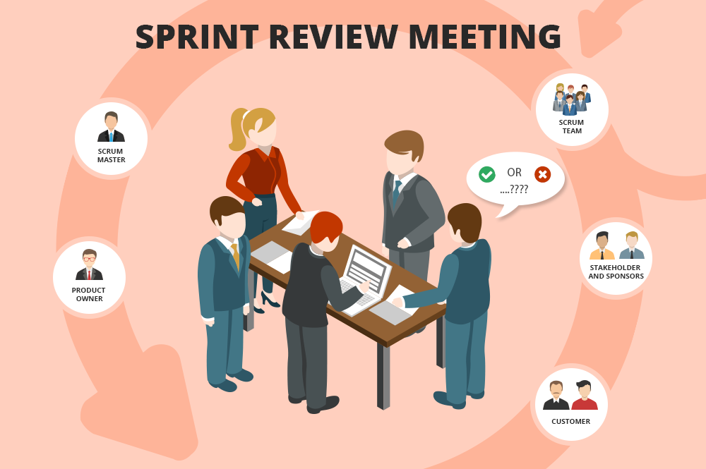
The Sprint Review
Team presents what it accomplished during the sprint
Typically takes the form of a demo of new features or underlying architecture
Informal
2-hour prep time rule
No slides
Whole team participates
Invite the world

Slide 27
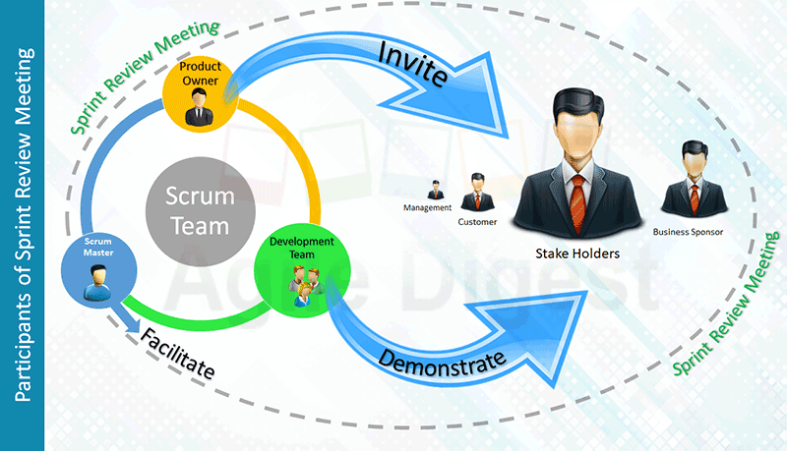
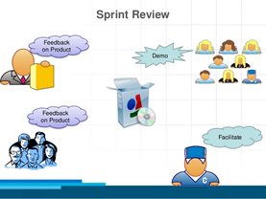
Sprint Review Cont:-

Slide 28
Scalability
Typical individual team is 7 ± 2 people
Scalability comes from teams of teams
Factors in scaling
Type of application
Team size
Team dispersion
Project duration
Scrum has been used on multiple 500+ person projects

Slide 29






Scaling: Scrum of Scrums

Slide 30
Scrum of Scrums
Scale Scrum up to large groups
Consisting of dividing the groups into Agile teams of 5-10
Each daily scrum within a sub-team ends by designating one member as “ambassador”
“Ambassador” participate in a daily meeting with ambassadors from other teams
Purpose
Scale the daily stand-up meeting when multiple teams are involved.
Its purpose is to support agile teams in collaborating and coordinating their work with other teams.

Slide 31
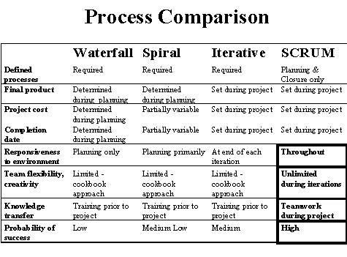
Scrum vs. Other Models

Slide 32
Fact versus Fantasy
First, a standard disclaimer: Process is only a second-order effect. The unique people, their feelings and qualities, are more influential.
Scrum practitioners do not report significant variation from the ideals of Scrum compared to its concrete use, presumably due to the relatively small and unambiguous set of practices. The most commonly reported reality checks are the encroachment of non-iteration work on to team members, and attempts by management to direct or organize the team, or solve—unasked—its problems. Scrum iterations have also failed when the Scrum Master does not regularly reinforce the project vision and Sprint goals, and the team drifts.

Slide 33
Strengths versus "Other"
Simple practices and management workproducts.
Individual and team problem solving and self-management.
Evolutionary and incremental requirements and development, and adaptive behavior.
Customer participation and steering.
Focus.
Openness and visibility.
Easily combined with other methods.
Team communication, learning, and value-building.
Team building via the daily Scrum, even if not in common project room.
Other: Could be viewed as a weakness, strength, or deliberate desirable exclusion, depending on point of view.

Slide 34
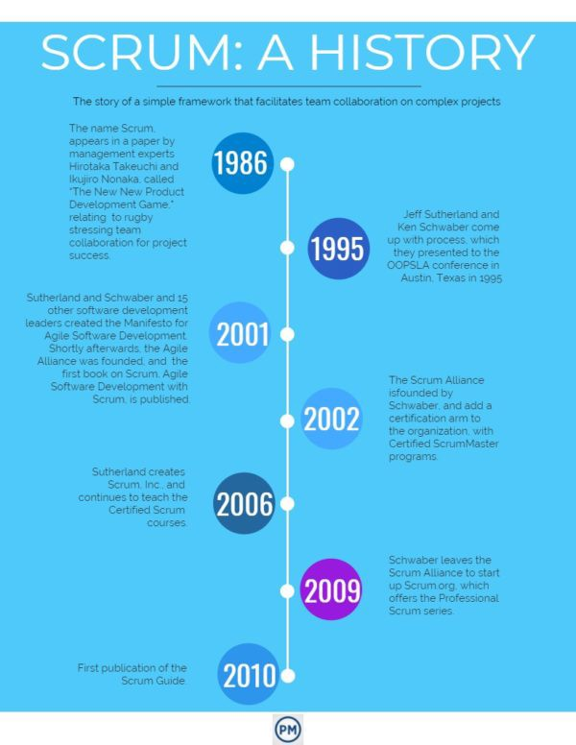
History of Scrum

Slide 35
Questions
Advantages of Scrum Meeting.
List out the values of scrum.
List out the Adoption Strategies.
Explain Process Mixtures of scrum.
List out the strengths of Scrum.
List out common mistakes and misunderstandings of scrum.

Slide 36
Session – 15
KANBAN

Slide 37
Topics to be discussed
Where did Kanban originate?
What is the Kanban Method?
Kanban Foundational Principles

Slide 38
KANBAN
INTRODUCTION
Kanban is a visual system for managing work.
It Visualizes both the process (the workflow) and the actual work passing through that process.
Kanban is a workflow management method designed to help us to visualize your work, maximize efficiency.
The goal of Kanban is to identify potential bottlenecks in your process and fix them, so work can flow through it cost-effectively at an optimal speed or throughput.
From Japanese, kanban is literally translated as billboard or signboard. Originating from manufacturing industry.
.

Slide 39
Where did Kanban originate? – A Brief History on Kanban
Kanban originated from the Toyota Production System (TPS). In the late 1940s, Toyota introduced “just in time” manufacturing to their production.
The approach represents a pull system.
This means that production is based on customer demand, rather than the standard push practice to produce amounts of goods and pushing them to the market.
Its core purpose is minimizing waste activities without sacrificing productivity.
The main goal is to create more value for the customer without generating more costs.

Slide 40
What is the Kanban Method?
Kanban is not a software development lifecycle methodology or an approach to project management.
It requires that some process is already in place so that Kanban can be applied to incrementally change the underlying process.
The Kanban Method is a process to gradually improve whatever you do- almost any business function can benefit from applying the principles of the Kanban Methodology.

Slide 41
Kanban Principles & Practices
The four foundational principles
• Start with what you are doing now:
• Agree to pursue incremental, evolutionary change
• Initially, respect current roles, responsibilities and job-titles
• Encourage acts of leadership at all levels

Slide 42
Questions
Define Kanban.
Where did Kanban originate?
What is the Kanban Method?
Explain Kanban Foundational Principles

Slide 43
Session – 16
KANBAN

Slide 44
Topics to be discussed
Where did Kanban originate?
What is the Kanban Method?
Kanban Foundational Principles
6 Core Practices of the Kanban
Positive side of Kanban
Main components of Kanban Board
WIP Limits in Kanban
Prioritizing the Kanban Backlog

Slide 45
6 Core Practices of the Kanban Method
Visualize the flow of work
Limit WIP (Work in Progress)
Manage Flow
Make Process Policies Explicit
Implement Feedback Loops
Improve Collaboratively, Evolve Experimentally (using the scientific method)

Slide 46
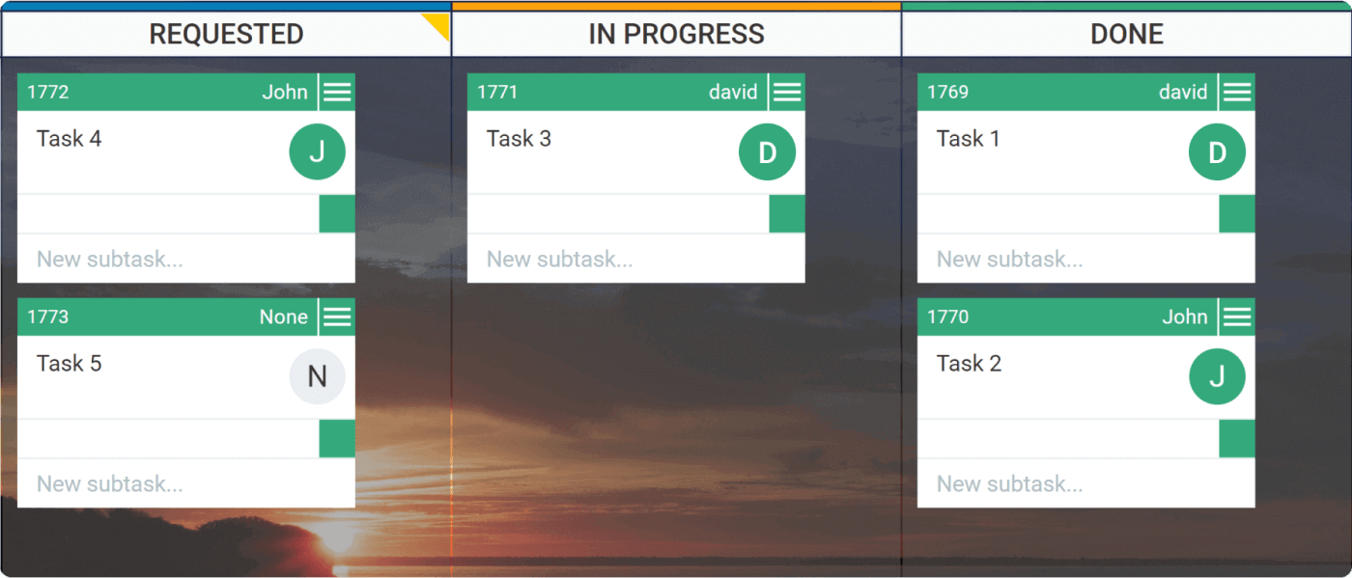
Visualize the flow of work:

Slide 47
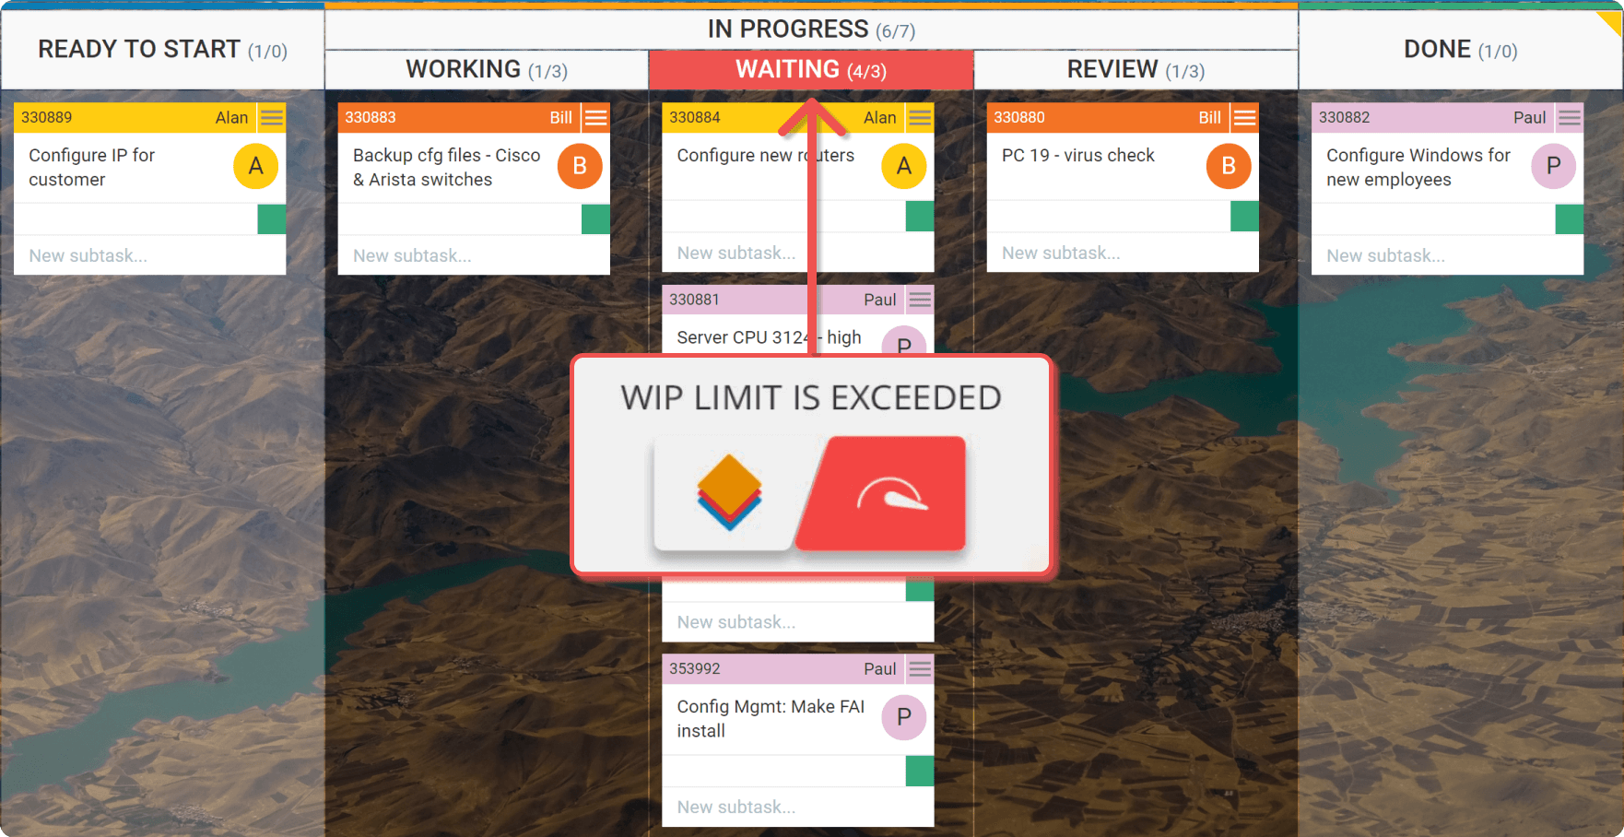
Limit work in progress
Limit WIP (Work in Progress)
Notes:
Setting maximum items per stage ensures that a card is only “pulled” into the next step when there is available capacity.

Slide 48
The Positive Side of Kanban
Everyone is on the same page
Kanban reveals bottlenecks in your workflow
Kanban brings flexibility
Your team gets more responsive
You focus on finishing work to boost collaboration and productivity

Slide 49
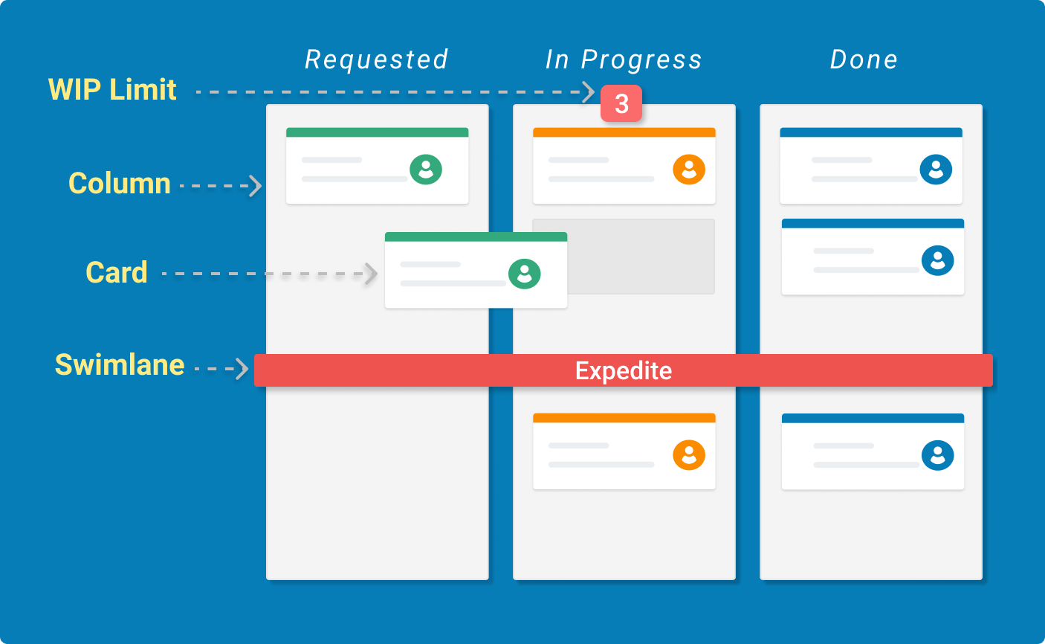
Main Components of the Kanban board

Slide 50
Kanban Cards – This is the visual representation of tasks. Each card contains information about the task and its status such as deadline, assignee, description, etc.
Kanban Columns – Each column on the board represents a different stage of your workflow. The cards go through the workflow until their full completion.
Work-in-Progress Limits – They restrict the maximum amount of tasks in the different stages of the workflow. Limiting WIP allows you to finish work items faster, by helping your team to focus only on current tasks.
Kanban Swimlanes – These are horizontal lanes you can use to separate different types of activities, teams, classes of service,

Slide 51
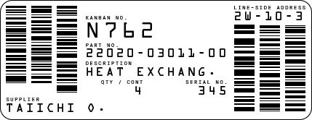
What Is a Kanban Card?
A Kanban card contains valuable information about the task and its status such as a summary of the assignment, responsible person, deadline, etc.
An example of a physical Kanban card.

Slide 52
Kanban WIP Limits

Slide 53
The acronym WIP stands for Work In Progress. WIP is the number of task items that a team is currently working on. It frames the capacity of your team’s workflow at any moment. Limiting work in progress is one of the core properties of Kanban. It allows you to manage your process in a way that creates smooth workflow and prevents overloads.

Slide 54
Prioritizing the Kanban Backlog
The backlog is the space where you place work items or ideas that will be done in the near or distant future. However, there is no guarantee that all tasks in the Kanban Backlog will be delivered. The items in this column are more like an option the team has for the future work rather than a commitment point.

Slide 55
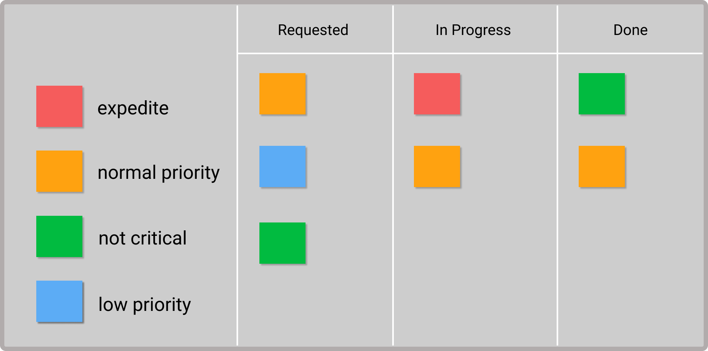
Prioritizing Tasks With Color Indicators

Slide 56
Questions
Define Kanban.
Where did Kanban originate?
What is the Kanban Method?
Explain Kanban Foundational Principles
List out the 6 Core Practices of the Kanban
How does Kanban work? – The Concept
What are WIP Limits in Kanban.

Slide 57
Session – 17
SAFe Methodology

Slide 58
Scaled Agile Framework (SAFe)
INTRODUCTION
The SAFe framework was introduced in 2011. It was originally called the “Agile Enterprise Big Picture”
The Scaled Agile Framework, or SAFe, methodology is an agile framework for development teams built on three pillars: Team, Program, and Portfolio.

Slide 59
What we Discuss
What is Scaled Agile Framework (SAFe)
Why to use Agile Framework
When to Use Scaled Agile Framework
Foundations of Scaled Agile Framework

Slide 60
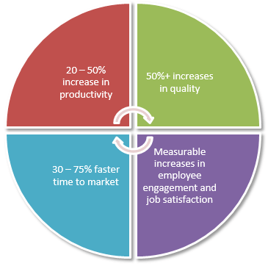
Why to use Agile Framework

Slide 61
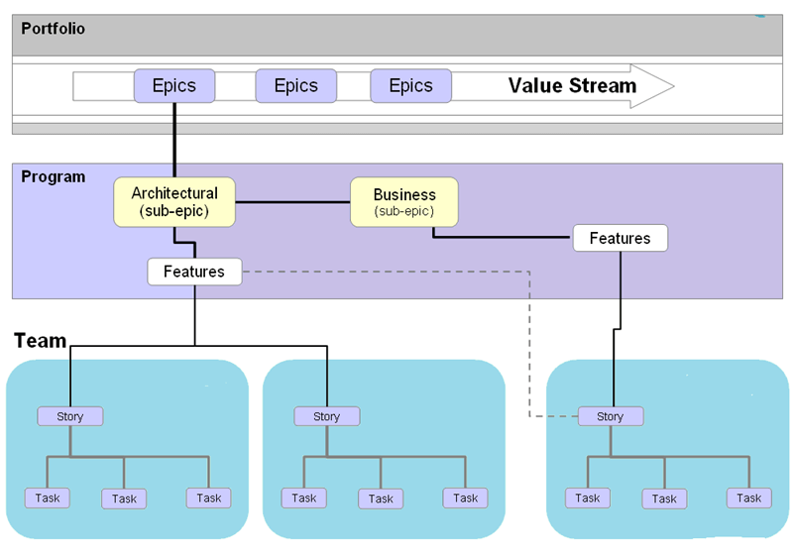
Agile Process Works

Slide 62

When to Use Scaled Agile Framework
•

Slide 63
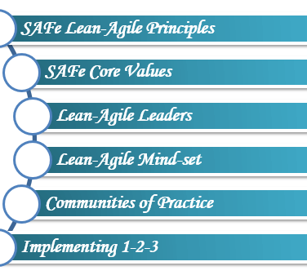
Foundations of Scaled Agile Framework

Slide 64
SAFe Lean-Agile Principles
These basic principles and values for SAFe must be understood, exhibited and continued in order to get the desired results.
• Take an economic view
• Apply systems thinking
• Build incrementally with fast, integrated learning cycles
• Base milestones on an objective evaluation of working systems
• Visualize and limit WIP, reduce batch sizes and manage queue lengths
• Decentralize decision-making

Slide 65
SAFe Agile Core Values
The SAFe agile is based on these four values.
Alignment:
Built-in Quality
Transparency:
Program Execution:

Slide 66
Lean Agile Leaders
The Lean-Agile Leaders are lifelong learners and teachers.
It helps teams to build better systems through understanding and exhibiting the Lean-Agile SAFe Principles.

Slide 67
Lean Agile Mind-Set
Lean-Agile mindset is represented in two things:
The SAFe House of Lean
Agile Manifesto

Slide 68
Session – 18
SAFe Methodology

Slide 69
How different than other Agile practices
Let's see how Scaled Agile framework is different from other agile practices,
• It's publicly available and free to use.
• Available in a highly approachable and usable form.
• it constantly/regularly modifies/maintains most commonly used agile practices.
• Offers useful extensions to common agile practices.
• Grounds agile practices to an enterprise context.
• Offers complete picture of software development.
• Visibility or transparency is more on all the levels.
• Continues or regular feedback on quality and improvement.

Slide 70
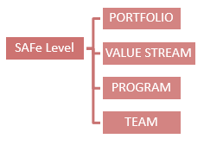
Different Levels in SAFE
There are two different types of SAFe implementation:
1. SAFe 4.0 implementation .
SAFe 3.0 implementation.

Slide 71
Team Level
Roles/Teams | Events | Artifacts
* Agile Team | * Sprint Planning | * Team Backlog
* Product Owner | * Backlog Grooming | * Non-Functional Requirements
* Scrum Master | * Daily Stand-Up | * Team PI Objectives
 | * Execution | * Iterations
 | * Sprint Demo | * Stories(Working Software)
 | * Sprint Retrospective | * Sprint Goals
 | * IP Sprints | * Built-In Quality
 |  | * Spikes
 |  | * Team Kanban

Slide 72
Program Level
Roles/Teams |  | Events |  | Artifacts
* DevOps |  | * PI(Program Increment) Planning |  | * Vision
* System Team |  | * System Demos |  | * Roadmap
* Release Management |  | * Inspect and Adopt Workshop |  | * Metrics
* Product Management |  | * Architectural Runway |  | * Milestones
* UEX Architect |  | * Release Any Time |  | * Releases
* Release Train Engineer(RTE) |  | * Agile Release Train |  | * Program Epics
* System Architect/Engineer |  | * Release |  | * Program Kanban
* Business Owners |  |  |  | * Program Backlog
* Lean-Agile Leaders |  |  |  | * Non-Functional Requirements
* Communities of Practice |  |  |  | * Weighted Shortest Job First (WSJF)
* Shared Services |  |  |  | * Program PI Objectives
* Customer |  |  |  | * Feature
 |  |  |  | * Enabler
 |  |  |  | * Solution
 |  |  |  | * Value Stream Coordination

Slide 73
Portfolio Level
Roles/Teams | Events | Artifacts
* Enterprise Architect | * Strategic Investment Planning | * Strategic Themes
* Program Portfolio Mgmt | * Kanban Portfolio(Epic) Planning | * Enterprise
* Epic Owners |  | * Portfolio Backlog
 |  | * Portfolio Kanban
 |  | * Non-Functional Requirements
 |  | * Epic and Enabler
 |  | * Value Stream
 |  | * Budgets(CapEx and OpEx)

Slide 74
Value Stream Level
Roles/Teams | Events | Artifacts
* DevOps | * Pre and Post PI(Program Increment) Planning | * Vision
* System Team | * Solution Demos | * Roadmap
* Release Management | * Inspect and Adopt Workshop | * Metrics
* Solution Management | * Agile Release Train | * Milestones
* UEX Architect |  | * Releases
* Value Stream Engineer(RTE) |  | *Value Stream Epics
* Solution Architect/Engineer |  | * Value Stream Kanban
* Shared Services |  | * Value Stream Backlog
* Customer |  | * Non-Functional Requirements
* Supplier |  | * Weighted Shortest Job First (WSJF)
 |  | * Value Stream PI Objectives
 |  | * Capability
 |  | * Enabler
 |  | * Solution Context
 |  | * Value Stream Coordination
 |  | * Economic Framework
 |  | * Solution Intent
 |  | * MBSE
 |  | * Set Based
 |  | * Agile Architecture

Slide 75
Questions
How different than other Agile practices
List out the principles of Agile Manifesto
Explain Different Levels in SAFE

